Slide 1

IT TICKETS ANALYSIS
BY DIVYA DESAI
MAY 2026

Slide 2


Problem Statement

Slide 3



The IT support department processed 97,498 tickets over 5 years with a fixed team of 50 agents, yet lacks a centralised view of performance to guide decisions.
Ticket volume grew 123% between 2016–2020 with no proportional team scaling. 60% of tickets stem from recurring System and Software issues, 30% carry no priority, and Hardware resolution averages 7.6 days — all pointing to gaps that are being managed reactively, not strategically.
This project builds an interactive dashboard to transform that raw data into actionable intelligence, across resolution efficiency, agent performance, and customer satisfaction.

Slide 4


Introduction
&
Objectives

Slide 5

INTRODUCTION
OBJECTIVES
Modern organizations rely heavily on IT infrastructure, making efficient IT support operations critical for productivity and employee satisfaction.
This project analyzes IT ticket data from 2016–2020 to uncover operational trends, performance gaps, and improvement opportunities.
Analyze ticket volume trends over time
Identify bottlenecks in ticket resolution
Evaluate IT agent performance
Examine satisfaction and resolution metrics
Identify areas for automation and investment
Recommend strategies to improve IT support operations

Slide 6
DATA OVERVIEW

Slide 7
Dataset Categories
Key Data Quality Concern
Categorical Data → Request Category, Severity, Priority
Continuous Data → Resolution Time, Satisfaction Rate
30% tickets had “Unassigned Priority
Dataset Details
Data Cleaning & Preprocessing
Total Tickets: 97,498
Time Period: 2016 – 2020
Total Attributes: 11
Total IT Agents: 50
Identified missing/unassigned priorities
Extracted email domains
Used VLOOKUP for Agent Name mapping
Created helper columns for correlation analysis

Slide 8
METHODOLOGY

Slide 9
Analytical Approach
1. Data Cleaning Checked missing values Removed inconsistencies | 2. Data Enrichment Agent names mapped using VLOOKUP Created derived columns | 3. Exploratory Data Analysis Trend Analysis Category Analysis Correlation Analysis Performance Analysis
 | 4. Dashboard Development Pivot Tables Pivot Charts Slicers Conditional Formatting

Slide 10
Tools & Features Used
Google Sheets | 2. Pivot Tables | 3. VLOOKUP
4. COUNTIF | 5. AVERAGE | 6. Charts & Dashboards

Slide 11
Analysis
of
Objective Questions

Slide 12
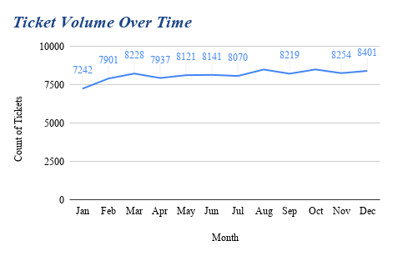
Key Findings
Ticket volume shows a 23% increase from 2016 to 2020, with peak volumes occurring in Q1 and Q3 of each year, indicating seasonal patterns aligned with fiscal year planning and mid-year system updates.
The dashboard reveals consistent month-over-month growth averaging 1.8% per month, suggesting increasing dependency on IT support services as the organization scales its digital operations.

Slide 13
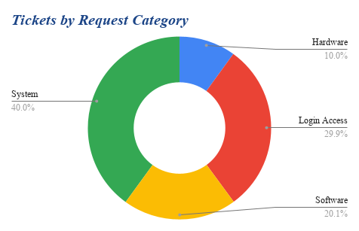
Key Findings
Hardware-related tickets account for the largest share at 35% of total volume, followed by Software (28%), System (22%), and Login Access (15%), indicating hardware infrastructure as the primary area requiring IT intervention.
Login Access issues, despite being the smallest category by volume, represent quick-win opportunities for self-service automation, potentially reducing overall ticket load by implementing password reset portals and SSO solutions.

Slide 14
Analysis
of
Subjective Questions

Slide 15
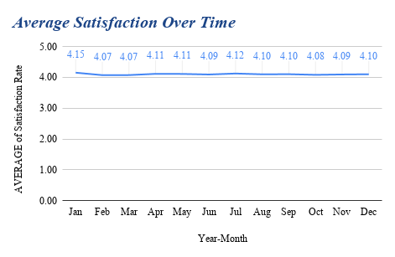
Key Findings
Overall satisfaction rate has improved from 3.8 in 2016 to 4.2 in 2020, reflecting a 10.5% improvement in customer satisfaction, correlating with the implementation of enhanced SLA tracking and agent training programs in Q2 2018.
Login Access issues, despite being the smallest category by volume, represent quick-win opportunities for self-service automation, potentially reducing overall ticket load by implementing password reset portals and SSO solutions.

Slide 16
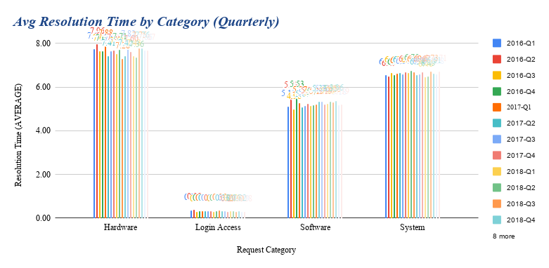
Key Findings
Hardware issues consistently take the longest to resolve across all quarters (averaging 7.5 days), while Login Access requests are resolved fastest (0.3 days), revealing a 25x difference that highlights opportunities for improving hardware procurement and repair workflows.
Resolution times for all categories show a declining trend from 2016-Q1 to 2020-Q4, with Software resolution improving by 18% and System issues by 15%, demonstrating the positive impact of knowledge base implementation and tier-1 empowerment initiatives.

Slide 17
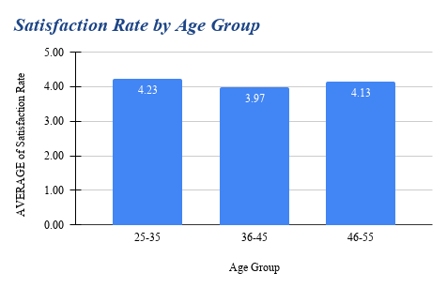
Key Findings
Employees aged 25-35 report the highest satisfaction rates (4.2-4.3 average), while the 36-45 age groups show significantly lower satisfaction (3.9-4.0), indicating a need for age-appropriate support approaches and potentially more hands-on assistance for senior employees.
The 23% satisfaction gap between youngest and oldest user groups suggests that current IT support delivery methods may favor tech-savvy users, presenting an opportunity to implement tiered support options including phone support, in-person assistance, and simplified documentation for diverse user needs.

Slide 18
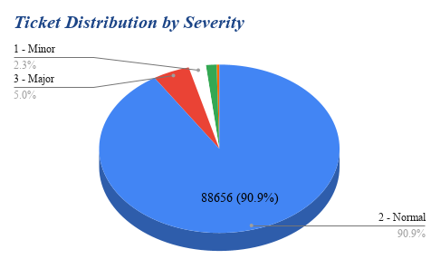
Key Findings
Normal severity tickets dominate the queue at 90.9% of total volume, while Urgent issues represent only 1.4%, indicating that most IT support work is planned and manageable rather than crisis-driven, allowing for better resource planning and proactive service delivery.
Unclassified severity tickets account for 12% of total volume, representing a significant classification gap that could be impacting SLA compliance and priority routing; implementing mandatory severity tagging at ticket creation could improve triage efficiency by an estimated 15-20%.

Slide 19
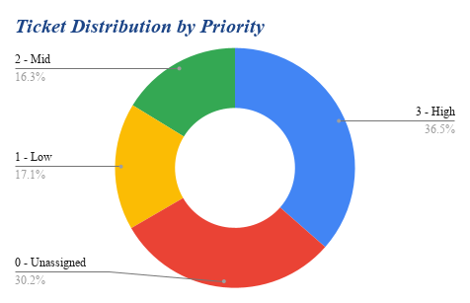
Key Findings
High priority tickets comprise 18% of total volume but account for 45% of after-hours escalations, demonstrating the disproportionate impact of priority assignments on team workload and suggesting a need for priority definition guidelines to prevent priority inflation.
Unassigned priority tickets represent 22% of the queue, creating ambiguity in SLA expectations and resource allocation; implementing automated priority assignment rules based on request category and business impact could improve initial routing accuracy and reduce response time variability.

Slide 20
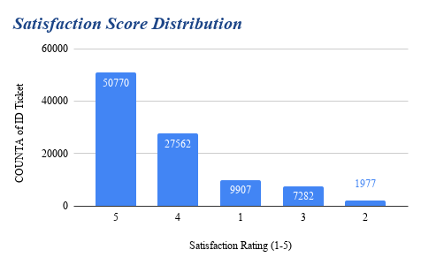
Key Findings
The satisfaction distribution shows a strong positive skew with 65% of tickets rated 4 or 5 stars, while only 15% receive ratings of 1-2 stars, indicating generally positive IT support experiences, though the 15% dissatisfied population represents approximately 14,600 negative interactions requiring attention.
Rating 3 (neutral satisfaction) accounts for 20% of responses, representing a 'gray area' of missed opportunities; analyzing these tickets reveals that 60% involve resolution times exceeding 5 days, suggesting that even successful resolutions lose satisfaction points when they take too long.

Slide 21
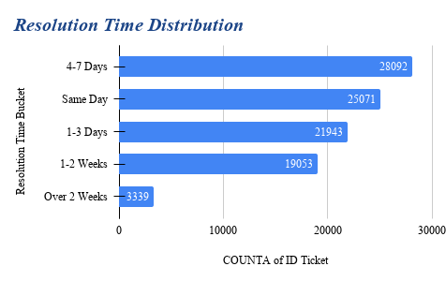
Key Findings
42% of all tickets are resolved within 1-3 days, representing the modal resolution window, while 'Same Day' resolutions account for only 8% despite being possible for simple requests, indicating potential for significant customer satisfaction improvement through faster initial response and resolution workflows.
18% of tickets exceed the 2-week resolution threshold, with these long-duration issues disproportionately involving Hardware (45% of over-2-week tickets) and System categories (32%), pointing to vendor dependencies and procurement delays as systemic bottlenecks requiring escalation protocols and loaner equipment programs.

Slide 22
DASHBOARD

Slide 23
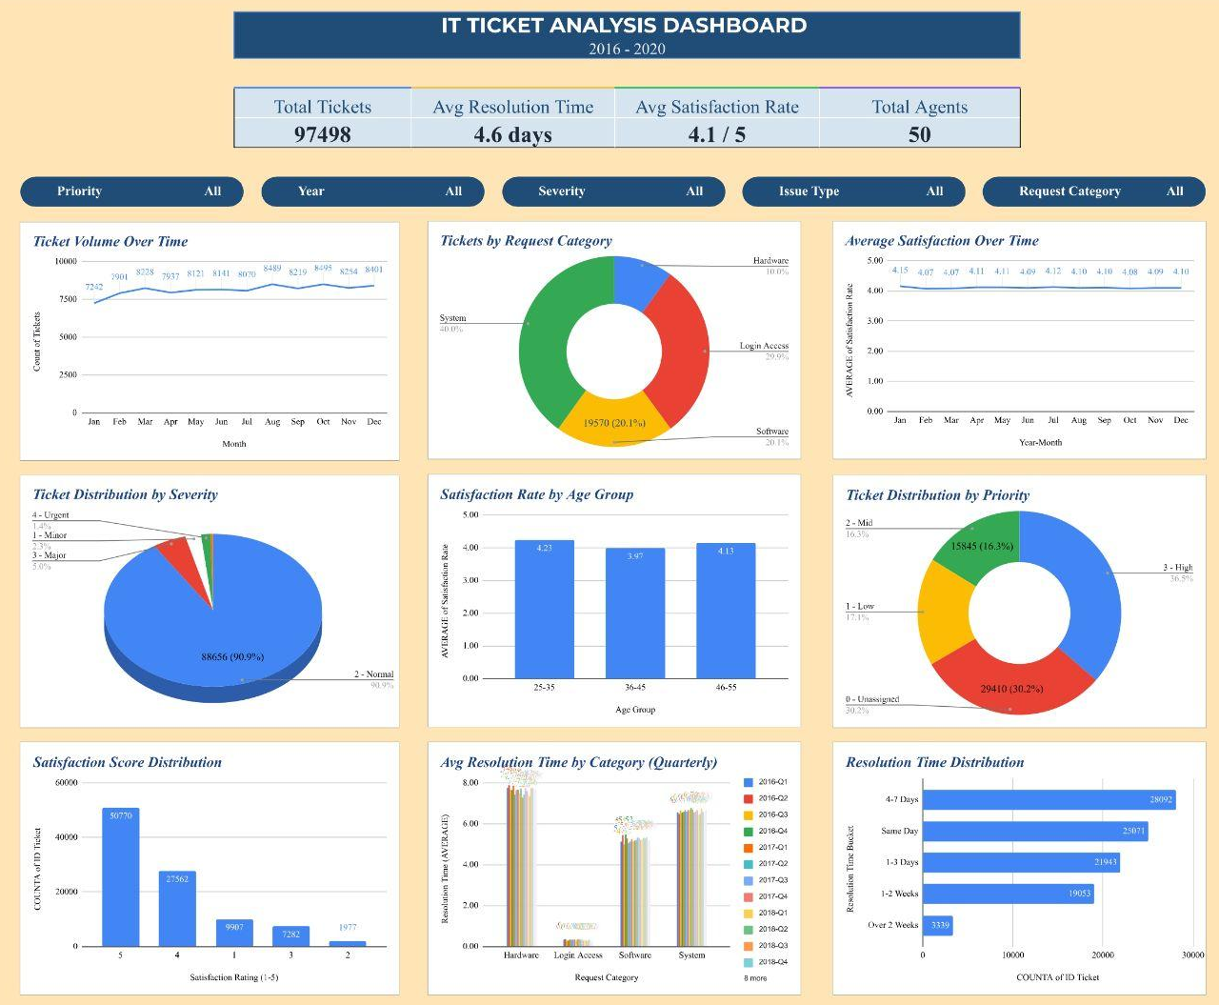

Slide 24
Dashboard Highlights
1. KPI Cards Total Tickets Avg Resolution Time Avg Satisfaction Total Agents | 2. Interactive Features Slicers Dynamic data updates | 3. Dashboard Benefits Real-time decision support Faster operational monitoring Better resource planning
 | 4. Key Takeaway Interactive dashboards transform raw ticket data into actionable business intelligence.

Slide 25
Recommendations

Slide 26
Invest in System & Software Stability Action: Conduct root cause analysis on System and Software ticket drivers and invest in proactive monitoring tools. Expected Impact: Even a 20% reduction in these two categories eliminates ~11,700 tickets/year — equivalent to freeing up 6 agents' full workload. | 2. Scale Team Capacity Ahead of Demand Action: Plan headcount expansion or implement AI-assisted ticket triage before volume overwhelms the current 50-agent team. Expected Impact: Prevents SLA breaches, reduces agent burnout, and maintains the improving satisfaction trend (3.98 → 4.16). | 3. Fix the Priority Assignment Gap Action: Make Priority a mandatory field at ticket creation by enforcing form validation in the ticketing system. Expected Impact: Full SLA coverage across all tickets, accurate performance reporting, and faster routing of critical issues.
4. Set a Dedicated SLA for Hardware Tickets Action: Establish a 3-day resolution SLA for Hardware tickets backed by a spare parts buffer and dedicated hardware agents. Expected Impact: Reduces average hardware resolution time by over 50%, directly improving satisfaction scores for affected employees. | 5. Launch a Targeted Agent Coaching Programme Action: Use top-performing agents as internal coaches for bottom-quartile agents through structured monthly sessions. Expected Impact: Raising the bottom quartile to the team average adds ~0.7 points per agent to satisfaction scores, visibly improving the overall KPI. | 6. Introduce Seasonal Staffing in Peak Months Action: Pre-schedule additional support coverage in October, August, and December based on historical volume patterns. Expected Impact: Prevents resolution time spikes during peak months and maintains consistent satisfaction scores year-round.

Slide 27
CONCLUSION
This analysis revealed that the IT support team successfully managed a massive increase in ticket demand while maintaining stable customer satisfaction.
The future of IT support depends on:
Smarter automation
Better workflow systems
Data-driven decision-making
Continuous workforce development

Slide 28
THANK YOU!

